Slide 1

P peline
The Data
Introductory Statistics: Correlation & Causality
© Jennifer Mankoff
The Data Pipeline; HCII; Spring 2014

Slide 2
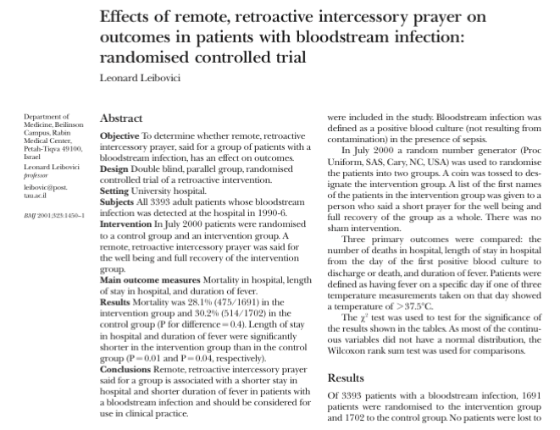
Leibovici, L. (2001). Effects of remote, retroactive intercessory prayer on outcomes in patients with bloodstream infection: Randomised controlled trial. Bmj, 323(7327), 1450-1451.
Notes:
HAND OUT ARTICLE, READ and discuss.
Can you envision a study that would convince you that a cause can lead to something happening in the past?

Slide 3
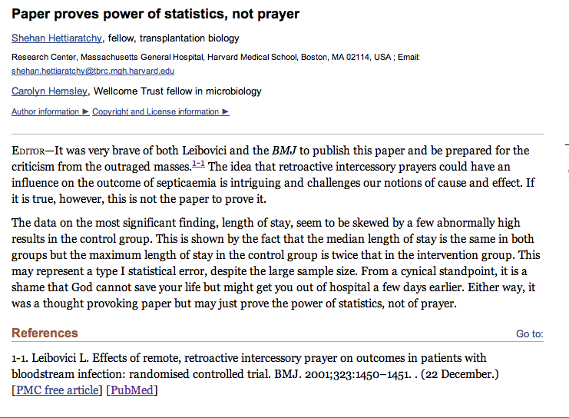
Adapted from class by Samantha Kleinberg

Slide 4
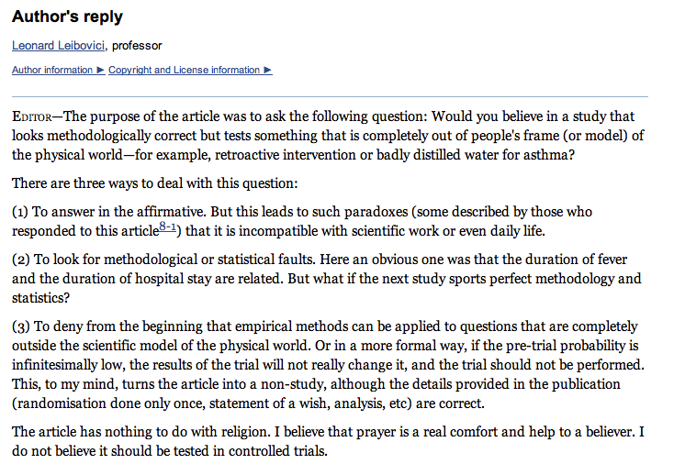
Leibovici’s reply
Adapted from class by Samantha Kleinberg
Notes:
http://www.ncbi.nlm.nih.gov/pmc/articles/PMC1122963/

Slide 5
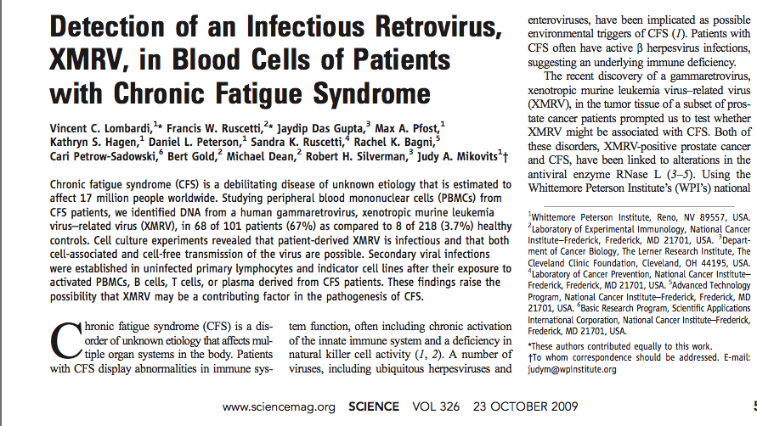
XMRV leads to CFS?
Adapted from class by Samantha Kleinberg

Slide 6
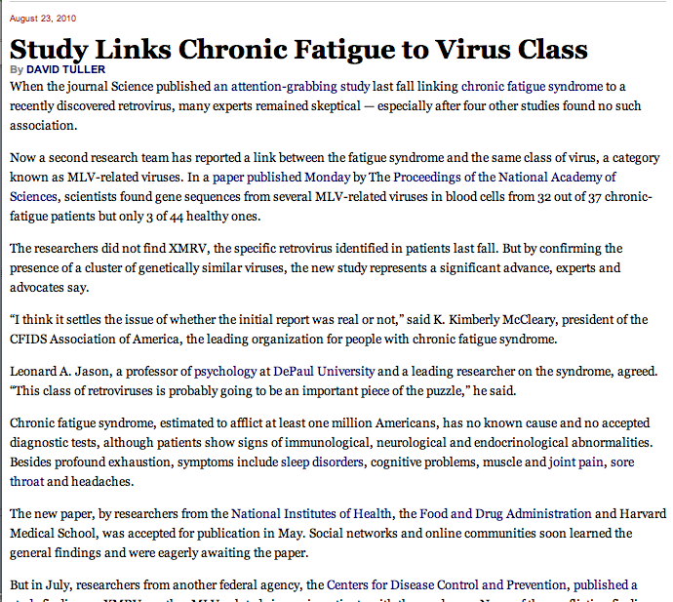
XMRV leads to CFS?
“I think it settles the issue of whether the initial report was real or not”
Adapted from class by Samantha Kleinberg

Slide 7
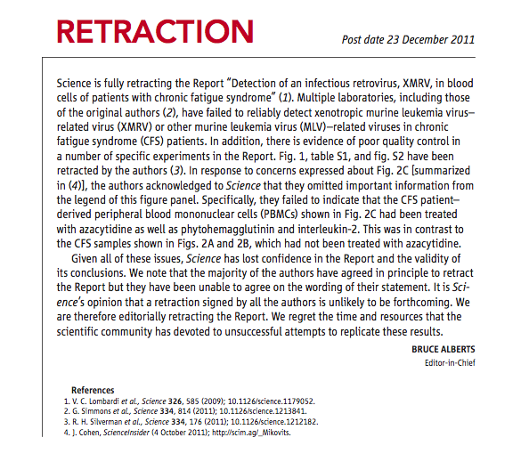
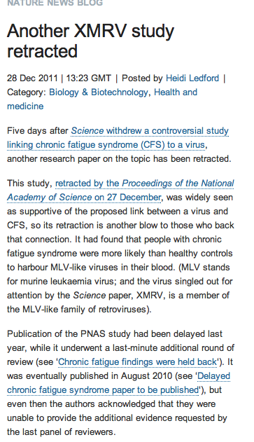
But …
Adapted from class by Samantha Kleinberg
Notes:
http://www.nature.com/news/the-scientist-who-put-the-nail-in-xmrv-s-coffin-1.11444
March 2011
Scientists at NIH present research showing that XMRV emerged from two different mouse viruses in the laboratory during the 1990s. The implication, one author told Nature, is that this virus, born in a laboratory, has probably been infecting laboratory samples for more than a decade, but not people. Meanwhile, a Nature profile of Judy Mikovits highlights growing tensions between Mikovits and her former collaborators on the initial report.

Slide 8
Goals
After this, you should be able to:
Understand how to diagram the relationships between variables
Explain the concept of causation

Slide 9
What is a Cause?
Why is it hard to prove causality
Why do we need to prove causality?
Adapted from class by Samantha Kleinberg
Notes:
Observational data/no single method for finding Prediction/explanation/intervention

Slide 10
Dependence/independence
Events that are independent
Flipping heads and then tails
Day of week and whether a patient had a heart attack (probably?)
Events that are dependent
Vice presidential candidate and presidential nominee
Diagnostic test being positive and whether patient has a disease
Adapted from class by Samantha Kleinberg

Slide 11

Regularities and experience
Past experience leads to expectation
Hear noise
Go to window
to verify
Prediction was false
Only with empirical evidence, can we make and test predictions
Adapted from class by Samantha Kleinberg

Slide 12
Problem: Overdetermination
Bob and Susie throwing rocks at glass bottle
Rocks hit simultaneously, but Susie threw first
Susie Aims
Susie Throws
Bob Aims
Bob Throws
Glass Breaks
Time

Slide 13
Problem: Preemption
Bob’s rock arrives first and breaks glass
But Susie still threw first and has perfect aim (breaks glass with P=1)
Susie Aims
Susie Throws
Bob Aims
Bob Throws
Glass Breaks
Time

Slide 14
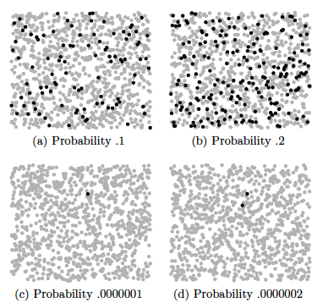
Problem: effect size
S. Kleinberg (2015) Why: A Guide to Finding and Using Causes. O’Reilly Media.
Notes:
Each dot represents 10,000 events, except in the lower two figures, where black
dots are single events.

Slide 15

Probability trajectory
Y
P(Y) changes at x
After x P(Y) is high
P is higher than before x
P remains high until y
Was Because Of!
x
Notes:
Image from: http://www.springerlink.com/content/vm062877643u8209/fulltext.pdf
http://carsguide.110mb.com/?l=Golf_ball
“A novice golfer swings at a golf ball and the ball begins rolling toward the cup. But a
squirrel comes along and kicks the ball away. Kicks of exactly this kind have a tendency to
prevent balls from making a birdie (reducing the probability of a birdie, say, from 0.5
to 0.1). Improbably enough (since there is only 10% of chance to make a birdie) and
luckily for the golfer, in this particular case, the ball comes off the squirrel’s foot on a
new trajectory (increasing the probability of a birdie to 0.7) to roll into the cup for a birdie
at a later time.”

Slide 16
Seatbelt should prevent death, but causes it

Slide 17
Correlation
Comparing Variables Systematically

Slide 18
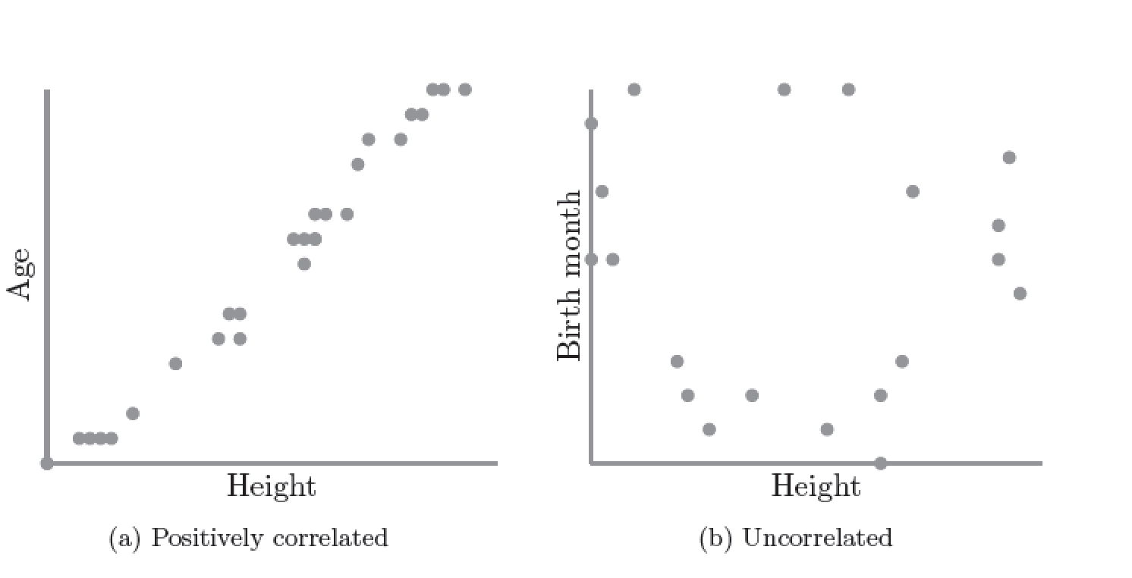
Correlation
S. Kleinberg (2015) Why: A Guide to Finding and Using Causes. O’Reilly Media.

Slide 19
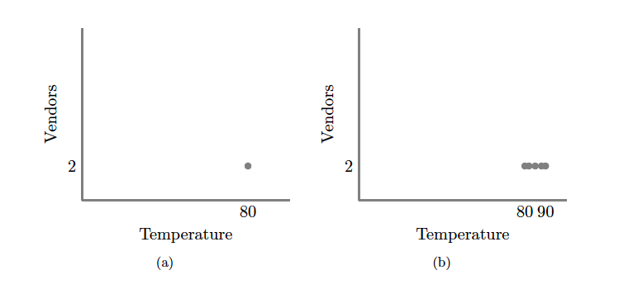
S. Kleinberg (2015) Why: A Guide to Finding and Using Causes. O’Reilly Media.
Notes:
No correlation without variation. Note: this is what happens if you ask only winners why they won

Slide 20
Scatter Plots and Correlation
A correlation analysis measures of association (relationship) between two variables
These variables change together
Usually scale (interval or ratio) variables
Analysis techniques limited to linear relationships

Slide 21
What is “Linear”?
Remember this:
Y=mX+B?
m (slope)
B (intercept)
Adapted from: http://www.sjsu.edu/people/steven.macramalla/courses/stats95/s1/lecture 10
Notes:
A slope of 2 means that every 1-unit change in X yields a 2-unit change in Y.

Slide 22
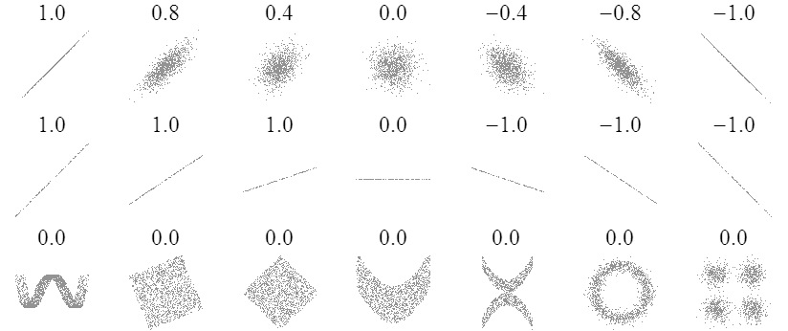
Sample Correlations
Adapted from: http://www.sjsu.edu/people/steven.macramalla/courses/stats95/s1/lecture 10
22

Slide 23
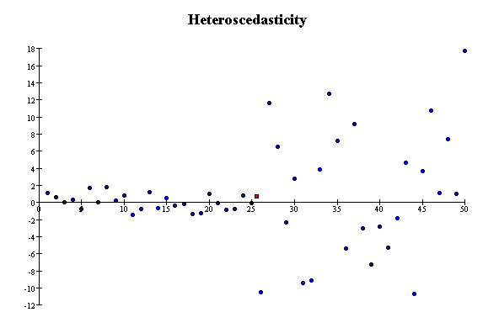
Correlation Assumptions
Key Assumptions:
X values are normally distributed within the population (for each Y)
Y values are normally distributed within the population (for each X)
X and Y have a linear relationship
There are no significant outliers
Scatter doesn’t vary over X or Y

Slide 24
Residual Analysis for Linearity
y
y
x
x
residuals
x
x
residuals
✓
Not Linear
Linear
Slide from: Statistics for Managers Using Microsoft® Excel 4th Edition, 2004 Prentice-Hall

Slide 25
Residual Analysis for Constant Variance (Homoscedasticity)
y
y
x
x
residuals
x
x
residuals
✓
Non-constant variance
Constant variance
Slide from: Statistics for Managers Using Microsoft® Excel 4th Edition, 2004 Prentice-Hall

Slide 26
Residual Analysis for Independence
✓
Not Independent
Independent
residuals
X
residuals
X
residuals
X
Slide from: Statistics for Managers Using Microsoft® Excel 4th Edition, 2004 Prentice-Hall

Slide 27
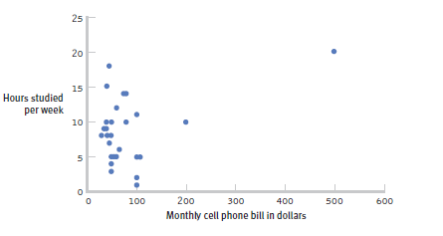
The effect of outliers
One outlier changed the correlation from -0.14 to 0.39!
Adapted from: http://www.sjsu.edu/people/steven.macramalla/courses/stats95/s1/lecture 10
Notes:
Note negative to positive change among other things
----- Meeting Notes (2/19/15 10:00) -----
cook's distance

Slide 28
Pearson Correlation Coefficient
(continued)
The population correlation coefficient ρ (rho) measures the strength of the association between the variables
The sample correlation coefficient r is an estimate of ρ and is used to measure the strength of the linear relationship in the sample observations
Adapted from http://www.fordham.edu/economics/Vinod/correl-regr.ppt

Slide 29
Calculating the Pearson Correlation Coefficient
Sample correlation coefficient:
or the algebraic equivalent:
where:
r = Sample correlation coefficient
n = Sample size
x = Value of the independent variable
y = Value of the dependent variable
Adapted from http://www.fordham.edu/economics/Vinod/correl-regr.ppt

Slide 30
Measuring correlation
Cups of coffee (X) vs. correct test answers (Y)
X | Y
0 | 1
1 | 1
3 | 3
4 | 5
5 | 5
Notes:
Mean of X 2.6, mean of y 3
Coffee is as related to correct answers as vice versa

Slide 31
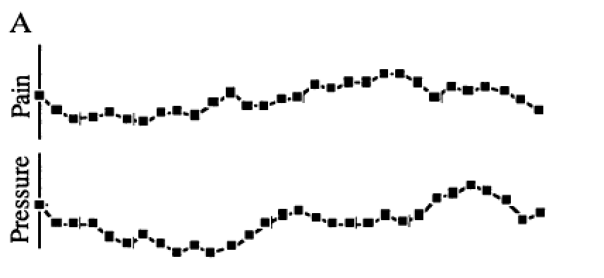
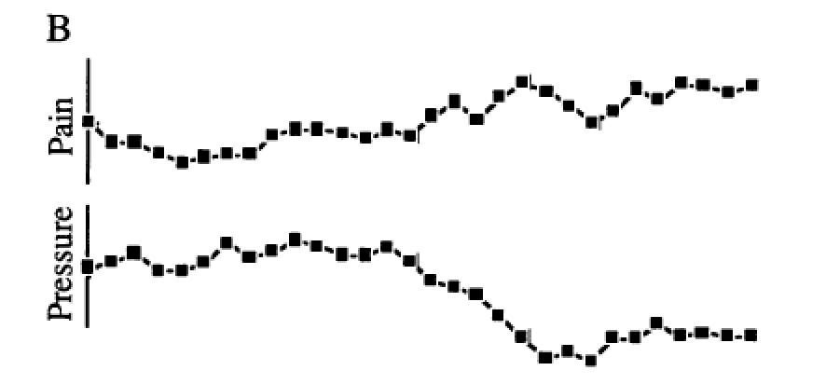
Correlation = 0!
Redelmeier DA, Tversky A (1996) On the belief that arthritis pain is related to the weather. Proceedings of the National Academy of Sciences 93(7):2895-2896.
Notes:
Cognitive bias
Fig. 1A were judged as positively related by 87%, as negatively related by 2%, and as unrelated by 11% of participants. The two uncorrelated sequences in Fig. 1B were judged as positively related by 3%, as negatively related by 79%, and as unrelated by 18% of participants.
----- Meeting Notes (8/31/15 17:30) -----
reformant

Slide 32
Correlation is not Causation
There is a 0.91 correlation between ice cream consumption and drowning deaths.
Does eating ice cream cause drowning?
Does grief cause us to eat more ice cream?
Adapted from: http://www.sjsu.edu/people/steven.macramalla/courses/stats95/s1/lecture 10

Slide 33
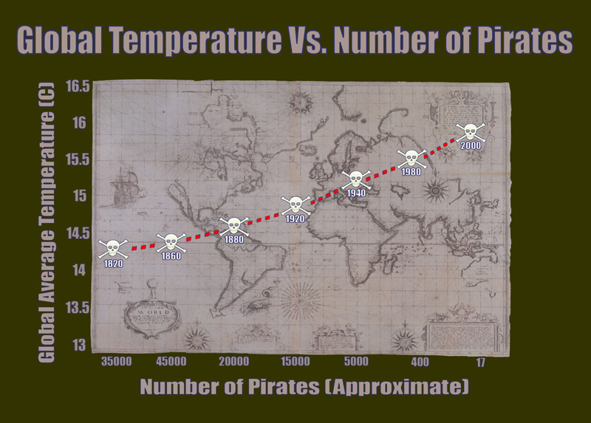
Correlation without causation (1)
http://bama.ua.edu/~sprentic
Notes:
http://bama.ua.edu/~sprentic/101%20Psych%20&%20Life--Correlation-causation.htm
But why shouldn’t we use pirates to predict temperature?
Now, why do we think pirates don’t cause global warming, or global warming doesn’t cause piracy?

Slide 34

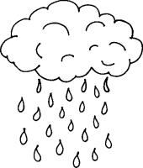
Correlation with some causation
Notes:
Directionality = why we can’t use it for prediction!
Umbrella vendors out before rain
Observe out of order

Slide 35
Correlation Summary
Measures association (linear relationship) between two variables
These variables change together
Usually scale (interval or ratio) variables
Limited in its applicability to normal, linearly related data with consistent scatter and no outliers
Often mistaken for causation
Notes:
changes in a few data-analysis decisions can increase the false-positive rate in a single study to 60%.

Slide 36
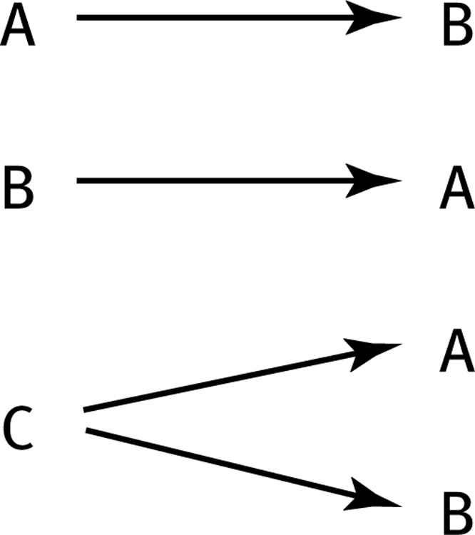
How can we test these associations?
Three Possible Causal Explanations for a Correlation
Adapted from: http://www.sjsu.edu/people/steven.macramalla/courses/stats95/s1/lecture 10

Slide 37
How can we test these associations?
Three Possible Causal Explanations for a Correlation
Adapted from: http://www.sjsu.edu/people/steven.macramalla/courses/stats95/s1/lecture 10
Notes:
Special case for C: C = Time (shared change over time)

Slide 38
Correlation Summary
Measures association (linear relationship) between two variables
These variables change together
Usually scale (interval or ratio) variables
Limited in its applicability to normal, linearly related data with consistent scatter and no outliers
Often mistaken for causation
Cannot easily determine if there is a mediating variable
Notes:
changes in a few data-analysis decisions can increase the false-positive rate in a single study to 60%.

Slide 39
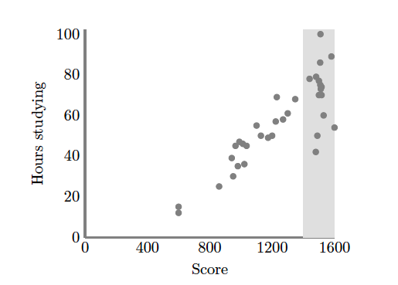
Causation without correlation
S. Kleinberg (2015) Why: A Guide to Finding and Using Causes. O’Reilly Media.
Notes:
Restricted range. Only observing grey area
Illustrate restricted range on board. When else does that happen? Surveying political website users

Slide 40
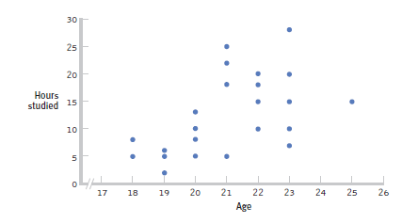
Restricted Range: Sampling Bias
Boys and girls who performed in the top 2% to 3% on standardized
Adapted from: http://www.sjsu.edu/people/steven.macramalla/courses/stats95/s1/lecture 10
Notes:
tests - a much smaller range than the full population from which the researchers could have drawn their sample.

Slide 41
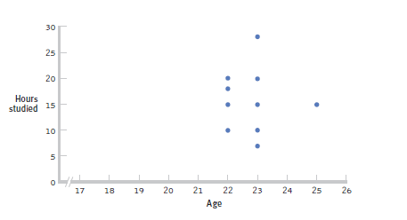
Further Restrictions
Only students between the ages of 22 and 25: r= 0.05.
Adapted from: http://www.sjsu.edu/people/steven.macramalla/courses/stats95/s1/lecture 10

Slide 42
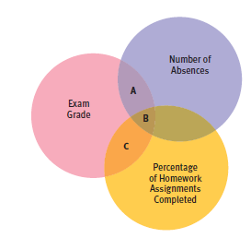
Partial Correlation
Quantifies the degree of association between two variables after statistically removing the association of a third variable with both of those two variables.
e.g., number of absences and exam grade, over and above the correlation of percentage of completed homework assignments with these variables.
Adapted from: http://www.sjsu.edu/people/steven.macramalla/courses/stats95/s1/lecture 10

Slide 43
Simpson’s Paradox
http://en.wikipedia.org/wiki/Simpson's_paradox
Introducing another variable may change our understanding of the data
It may even reverse the initial conclusions

Slide 44
A situation where the subgroups are always the way to go
 | Treatment A | Treatment B
Small Stones | Group 1 93% (81/87) | Group 2 87% (234/270)
Large Stones | Group 3 73% (192/263) | Group 4 69% (55/80)
Both | 78% (273/350) | 83% (289/350)
Notes:
The practical significance of Simpson's paradox surfaces in decision making situations where it poses the following dilemma: Which data should we consult in choosing an action, the aggregated or the partitioned? In the Kidney Stone example above, it is clear that if one is diagnosed with "Small Stones" or "Large Stones" the data for the respective subpopulation should be consulted and Treatment A would be preferred to Treatment B. But what if a patient is not diagnosed, and the size of the stone is not known; would it be appropriate to consult the aggregated data and administer Treatment B? This would stand contrary to common sense; a treatment that is preferred both under one condition and under its negation should also be preferred when the condition is unknown.

Slide 45
Gender Discrimination?
 | Applicants | Admitted
Men | 8442 | 44%
Women | 4321 | 35%
Notes:
On the other hand, if the partitioned data is to be preferred a priori, what prevents one from partitioning the data into arbitrary sub-categories (say based on eye color or post-treatment pain) artificially constructed to yield wrong choices of treatments? Pearl[2] shows that, indeed, in many cases it is the aggregated, not the partitioned data that gives the correct choice of action. Worse yet, given the same table, one should sometimes follow the partitioned and sometimes the aggregated data, depending on the story behind the data; with each story dictating its own choice. Pearl[2] considers this to be the real paradox behind Simpson's reversal.

Slide 46
Gender Discrimination?
Dept | Men | Women
A | 825/62% | 108/82%
B | 560/63% | 25/68%
C | 325/37% | 593/34%
D | 417/33% | 375/35%
E | 191/28% | 393/24%
F | 373/6% | 341/7%
Bickel et al.[13]: women tended to apply to competitive departments with low rates of admission (English), men tended to apply to less-competitive departments with high rates of admission engineering and chemistry)
Notes:
On the other hand, if the partitioned data is to be preferred a priori, what prevents one from partitioning the data into arbitrary sub-categories (say based on eye color or post-treatment pain) artificially constructed to yield wrong choices of treatments? Pearl[2] shows that, indeed, in many cases it is the aggregated, not the partitioned data that gives the correct choice of action. Worse yet, given the same table, one should sometimes follow the partitioned and sometimes the aggregated data, depending on the story behind the data; with each story dictating its own choice. Pearl[2] considers this to be the real paradox behind Simpson's reversal.

Slide 47
Correlation Summary
Measures association (linear relationship) between two variables
These variables change together
Usually scale (interval or ratio) variables
Limited in its applicability to normal, linearly related data with consistent scatter and no outliers
Often mistaken for causation
Cannot easily determine if there is a mediating variable
Range restriction & other manipulations can affect or even reverse outcomes (Simpson’s paradox)
Notes:
changes in a few data-analysis decisions can increase the false-positive rate in a single study to 60%.

Slide 48

Features of ρ and r
Unit free
Range between -1 and 1
The closer to 0, the weaker the linear relationship
Does not imply causality!
Adapted from http://www.fordham.edu/economics/Vinod/correl-regr.ppt

Slide 49
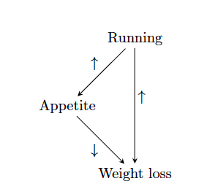
Causation without correlation
S. Kleinberg (2015) Why: A Guide to Finding and Using Causes. O’Reilly Media.
Notes:
But in addition to correlation without causation, we can have causation without correlation

Slide 50
Causation without correlation
Treatment
 | Dead | Alive
A | 85 | 215 (72%)
B | 59 | 241 (80%)
Total | 144 | 456
Notes:
Treatment B is standard, A is experimental approach
Who wants treatment A and who wants treatment B?

Slide 51
Causation without correlation (2)
Treatment | Men |  | Women |  | Combined
 | Dead | Alive | Dead | Alive | Dead | Alive
A | 80 | 120 (60%) | 5 | 95 (95%) | 85 | 215 (72%)
B | 20 | 20 (50%) | 39 | 221 (85%) | 59 | 241 (80%)
Total | 100 | 140 | 44 | 316 | 144 | 456
Baker SG, Kramer BS (2001) Good for women, good for men, bad for people: Simpson's paradox and the importance of sex-specific analysis in observational studies. Journal of women's health & gender-based medicine 10: 867-872
Notes:
http://www.ncbi.nlm.nih.gov/pubmed/11747681
Ask: so what actually happened?
Levels of granularity matter!!!
Men have higher mortality rate, and more of them got treatment A than B, biasing the sample and vice versa with women.

Slide 52
How do we infer causality? How do we prove it?
Returning to Causality

Slide 53
Process vs Frequency data
Formulate
hypotheses
(Collect) & Analyze data to test hypotheses
(Bayesian inference) (Statistical inference)

Slide 54
Process vs Frequency Data
Potential for Logical Error
Potential for Systematic Error
Formulate
hypotheses
(Collect) & Analyze data to test hypotheses

Slide 55
Process vs Frequency Data
Formulate
hypotheses
(Collect) & Analyze data to test hypotheses
Potential for
Random Error;
Errors of Interpretatino
Evaluate hypotheses
Notes:
Random error (chance) can be controlled by statistical significance
or by confidence interval

Slide 56
Inference
Blends background knowledge & data
Estimates actual ratio in the population at large of things being tested for
Bayesian in nature
Helps provide grounding for what is expected in your data, lets you judge if there is sample bias, etc.

Slide 57
Theory vs empiricism
Theoretical definition
Empirical definition
Contiguity
Temporal priority
Necessary connection
Contiguity
Temporal priority
Constant conjunction
Adapted from class by Samantha Kleinberg
Notes:
Contiguity: cause and effect are nearby
Temporal priority: cause occurs prior to effect
Constant conjunction: cause regularly followed by effect

Slide 58
INUS condition
A cause is an insufficient (I) but non-redundant (N) part of an unnecessary (U) but sufficient condition (S)
Adapted from class by Samantha Kleinberg

Slide 59
INUS example
Lit match (C) may cause house fire (E)
Many cases where lit match does not cause fire
Many cases of fire without lit match (Y)
For lit match to cause fire, need oxygen, flammable materials, etc. (X)
C
E
y
Adapted from class by Samantha Kleinberg

Slide 60
INUS conditions summary
X are conditions needed for C to cause the effect
Y is a set of sufficient conditions for E
C is INUS condition of E iff:
For some X and some Y (CX or Y) is necessary and sufficient condition of E
C is not a sufficient condition of E
X is not a sufficient condition of E
There are sets of conditions that result in effect, cause is necessary part of one of those sets.
Adapted from class by Samantha Kleinberg

Slide 61
Problems for INUS
Insufficient to rule out spurious relationships
Common cause of two effects
Chance regularities
Strength of contribution
Relative nature
Adapted from class by Samantha Kleinberg

Slide 62
Murder mystery
June 27, 2005: A sleepwalker, Benjamini Adoyo goes to sleep disorder clinic. Had been wandering through house, and sometimes shaking his wife while standing over her and babbling. He had no memory of these episodes.
August 10, 2005: After sleep study, center says he has non-REM parasomnia.
October 17, 2005: Visits clinic again. Medication increased.
October 19, 2005: Adoyo is arrested and charged with killing his wife
In general, parasomniacs can kill people with no intention, awareness or memory of committing the crime
Is it murder or a result of his sleep disorder?
The Case of the Sleeping Slayer. Scientific American, September 2012, p 34-39.

Slide 63
Sleepwalker or murderer?
911 call, 3:41 am October 19, 2005
Confessed, but was confused and asked about wife’s welfare
Core question: parasomnia was known prior to incident, but was it the cause of wife’s murder?
Operator: What’s going on?
Adoyo: You just get here
Operator: You need to tell me what’s going on.
Adoyo: Somebody is dead
Operator: Somebody is dead?
Adoyo: Yes.
Operator: Where are they at?
Adoyo: In their house. Somebody is dead. Get here.
Adapted from class by Samantha Kleinberg

Slide 64
The verdict
Wasn’t nearby wife (proximity is important)
Usually no motive, but had been arguing with wife
Assaulted wife in bedroom with hammer, chased into hall & bathroom, stabbed and strangled her
Unusual to see so many mechanisms at once
Adoyo pled guilty to second degree murder
Adapted from class by Samantha Kleinberg

Slide 65
Another Example
Sally Clark’s 1st son died in 1996, as a result of SIDS
Her 2nd son died in 1999, also as a result of SIDS
Prosecutors argued too unlikely to both be SIDS, must be murder.
Chance of SIDS = 1/8,543 so chance of 2 deaths = 1/(8,543*8,543) (approx 1 in 73 million)
What’s wrong with this?
Adapted from class by Samantha Kleinberg
Notes:
Meadow took a report estimating the chance
of SIDS as 1 in 8,543 and then said two would be one in 8,543*8,543 – approximately
73 million.1
Have you ever said it’s too unlikely to be true? Something unlikely has already happened!

Slide 66
Token causality
What happens in general, versus what happened in a particular instance
Parasomnia causing murder, versus parasomnia causing murder of Adoyo’s wife
Why do we need to talk about it separately?
Adapted from class by Samantha Kleinberg

Slide 67
Counterfactuals
How do we distinguish between things that are necessary in that they are required for the effect, and those that just co-occur?
Had things been different, what would have happened?
Adapted from class by Samantha Kleinberg

Slide 68
Counterfactual (basic idea)
Had C not have happened, E would not have either
Ex: umbrella vendors and rain
Adapted from class by Samantha Kleinberg
Notes:
Had cause not taken place, effect would not have happened either

Slide 69
Bayesian Vs Statistical Approaches
Formalizing Causality

Slide 70
Common Statistical Tests: T-Test
T-Test
Tests for difference between two samples
Best used to determine what is ‘worthy of a second look’
Limited in its applicability to normal, independent data
The more implausible the hypothesis, the greater chance that it is a ‘false alarm’
Does not help to document effect size [the actual difference between groups], just effect likelihood
Susceptible to ‘data dredging’
Varied tests looking for a significant result
Adjustments mid experiment
Notes:
changes in a few data-analysis decisions can increase the false-positive rate in a single study to 60%.

Slide 71
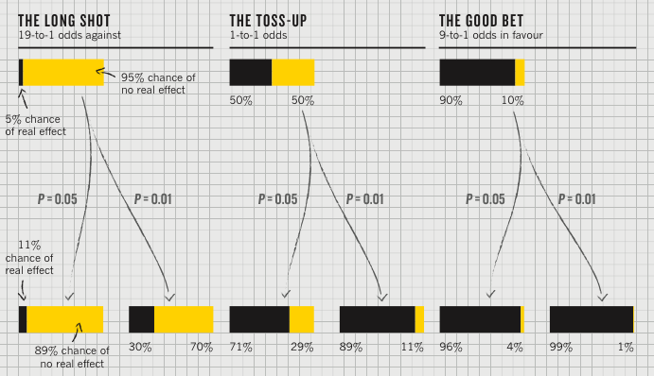
P value [Nuzzo]
P value
Best used to determine what is ‘worthy of a second look’ [Nuzzo]
Limited in its applicability

Slide 72
Plausibility of the hypothesis (inference)
P value
Best used to determine what is ‘worthy of a second look’ [Nuzzo]
Limited in its applicability
‘Prior’: Before the
experiment

Slide 73
‘Statistical significance’
P value
Best used to determine what is ‘worthy of a second look’ [Nuzzo]
Limited in its applicability
Calculated p value
Notes:
Does not incorporate the inference (the top of this chart) directly

Slide 74
Actual implications of the p-value
P value
Best used to determine what is ‘worthy of a second look’ [Nuzzo]
Limited in its applicability
Hypothesis more plausible than it should be (Type I Error)
Notes:
Does not incorporate the inference (the top of this chart) directly

Slide 75
Actual implications of the p-value
P value
Best used to determine what is ‘worthy of a second look’ [Nuzzo]
Limited in its applicability
Alternatively, a small sample may cause a Type II error (failure to detect a true difference) due to random sampling bias
Notes:
Does not incorporate the inference (the top of this chart) directly

Slide 76
Type II errors (failure to detect difference) also caused by small effect size
S. Kleinberg (2015) Why: A Guide to Finding and Using Causes. O’Reilly Media.
Notes:
Each dot represents 10,000 events, except in the lower two figures, where black
dots are single events.
Is this a problem?

Slide 77
Summary
Start with process data and analysis, only then explore frequency data and analysis
Interpreting results must be done with respect to real world expectations about the population
Potential Pitfalls typically leading to Type I errors
Low rate of replication of findings [Ionnadis]
Bias (‘findings’ may actually be measuring bias) [Ionnadis]
Lack of careful data exploration (charts & summarization) [Hart]
Potential Pitfalls leading to Type II Errors
Low power (probability of rejecting a false hypothesis i.e. Type II errors) in studies [Colquhuon]
Notes:
Note: Add a little more about the last point

Slide 78
Beyond Binary Hypothesis Testing
What was role of cause in effect’s occurrence?
Anne drives drunk and crashes car. What’s significance of her drinking for the crash?
Could be
Because of
Despite
Independently of

Slide 79
y is because of x if
P(y) changes after x
P(y) is high after x
P(y) is higher than it was before x
P(y) remains high until it occurs

Slide 80
Four relations
Despite
y is Y despite x if the probability of Y is lowered after x_{t’}
Because
y is Y because of x if the probability of Y is increased after x_{t’} and remains increased until y_{t}
Autonomously
y is Y autonomously of x if the probability of Y changes at x_{t’}, this probability is high, but then decreases before y_{t}
Independently
y is Y independently of x if the probability of Y is the same just after x_{t’} as it is just before x_{t’}

Slide 81
Probabilities from data
How to determine probability of heads/tails from coin flip?
Frequency of event x
#(x) = number of times it is observed
Relative frequency
#(x)/N, where N is number of observations
As N→∞, relative frequency →P(x)
Adapted from class by Samantha Kleinberg

Slide 82
Conjunction
For independent events
P(A∧B)=P(A)P(B)
A∧B
A
B
Adapted from class by Samantha Kleinberg

Slide 83
Conditional probability
P(A∧B)=P(A|B)P(B), where P(B)>0
Note, if A and B independent, P(A∧B)=P(A)P(B)
Then:
Adapted from class by Samantha Kleinberg

Slide 84
Example of Bayes rule
Probability of disease (d) is 0.001
But diagnostic test not foolproof
P(+|d) = 0.98
P(+|¬d) = 0.1
Given a positive test, what’s probability patient has disease?
Adapted from class by Samantha Kleinberg

Slide 85
Example continued
Adapted from class by Samantha Kleinberg

Slide 86
Why is understanding conditional probability important?
Sally Clark case
Mother whose first son died suddenly in 1996
Second son died similarly in 1998
SIDs or murder?
Case focused on statistic
Probability of death from SIDs = 1/8543
Probability of two deaths from SIDs = 1/8543*1/8543 ≈ 1/73 million!
See: www.statslab.cam.ac.uk/~apd/SallyClark_report.doc
Adapted from class by Samantha Kleinberg
Notes:
How should we formulate this problem? P(SIDS | D2)? Or P (D2 | D1 <- SIDS)
Better yet, among families where two babies die, what percentage are murdered? What percentage get SIDS? Relative proportion is a good measure of what will happen.

Slide 87
Probabilistic causality: basic idea
C causes E if
P(E|C)>P(E)
Or P(E|C)>P(E|¬C)
Adapted from class by Samantha Kleinberg

Slide 88
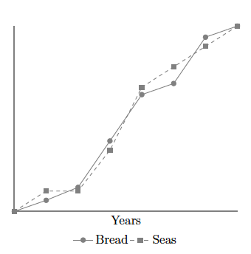
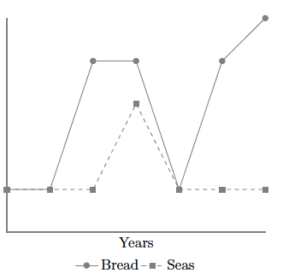
Problem: Nonstationarity
Sober, E. (2001). Venetian sea levels, British bread prices, and the principle of the common cause. The British Journal for the Philosophy of Science, 52(2), 331

Slide 89
Problem: Indeterminism
If lamp on, tv also on, so P(L|T)=1
Does switch screen off L and T?
0.9
lamp
switch
0.9
tv
Adapted from class by Samantha Kleinberg

Slide 90
Problem: Overdetermination
Bob and Susie throwing rocks at glass bottle
Rocks hit simultaneously, but Susie threw first
Susie Aims
Susie Throws
Bob Aims
Bob Throws
Glass Breaks
Time

Slide 91
Problem: Preemption
Bob’s rock arrives first and breaks glass
But Susie still threw first and has perfect aim (breaks glass with P=1)
Susie Aims
Susie Throws
Bob Aims
Bob Throws
Glass Breaks
Time

Slide 92
Probability trajectory
Y
P(Y) changes at x
After x P(Y) is high
P is higher than before x
P remains high until y
Was Because Of!
x
Notes:
Eg Seatbelt should prevent death, but causes it
Image from: http://www.springerlink.com/content/vm062877643u8209/fulltext.pdf
http://carsguide.110mb.com/?l=Golf_ball
“A novice golfer swings at a golf ball and the ball begins rolling toward the cup. But a
squirrel comes along and kicks the ball away. Kicks of exactly this kind have a tendency to
prevent balls from making a birdie (reducing the probability of a birdie, say, from 0.5
to 0.1). Improbably enough (since there is only 10% of chance to make a birdie) and
luckily for the golfer, in this particular case, the ball comes off the squirrel’s foot on a
new trajectory (increasing the probability of a birdie to 0.7) to roll into the cup for a birdie
at a later time.”

Slide 93
The probability of death (D) within 30 minutes of poisoning (O) is 0.8
But if an antidote (A) is given within 10 minutes of poisoning, the probability of death is reduced to 0.001
However the antidote has occasional side effects, so the probability of death when an antidote is given in the absence of the poison is still 0.001
Is O a cause of death? Is A?

Slide 94
Poison and antidote
P(D|O)=0.8 in 30 minutes
P(D|A^O)=0.001 if within 10 minutes of O
P(D|A^¬O)=0.001
Are A and O positive, negative, neutral or mixed? Better handled by Suppes or Eells?
Can impact on a specific instance be different than that at type level? When?

Slide 95

Poison and antidote
X X
1
0.8
P(death)
0.001
antidote
t
Notes:
http://en.wikipedia.org/wiki/Poison

Slide 96
Why are background contexts needed?
What if poison and antidote are administered at same time?
What about exposure that provides resistance to later bacteria?

Slide 97
Counterexample (sort of)
C likely to survive until t2 but not a later time
P(death|A)=P(death|disease)
P(death|cure)=0
BUT residual chance of death from A
C
A
B
Patient
Ineffective drug
Cure
t
t1
t2
time

Slide 98
Caveats
How can we know all the important factors?
How can we find the probability trajectory?

Slide 99
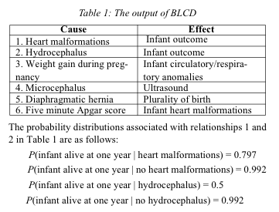
Example: infant mortality
n binary variables = 2^n entries
Mani, S., & Cooper, G. F. (2004). Causal Discovery Using a Bayesian Local Causal Discovery Algorithm. Proceedings of MedInfo, 731-735

Slide 100
Graphical model
Describes independencies in a set of variables
Directed
Bayesian network

Slide 101
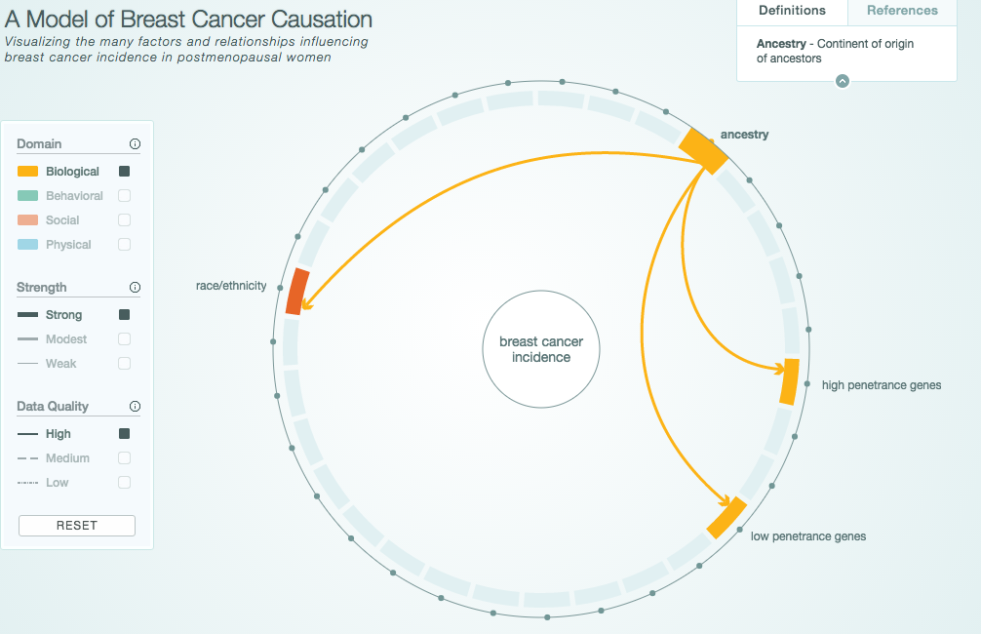
Graphical Model Example
http://www.cabreastcancer.org/causes/#

Slide 102
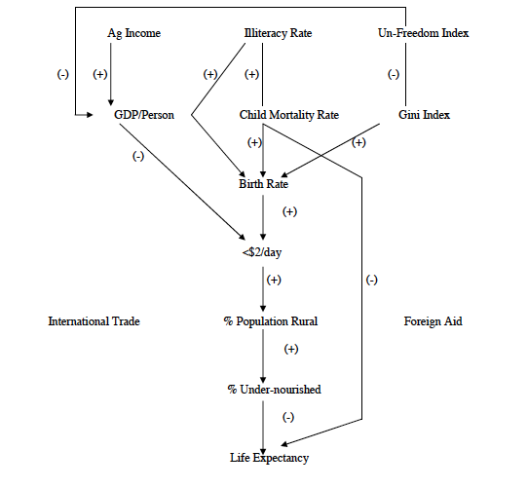
Application: Causes and effects of poverty
Bessler, D. A. (2003). On world poverty: Its causes and effects. Food and Agricultural Organization (FAO) of the United Nations, Research Bulletin, Rome

Slide 103
Graphical models and explanation
Graphical model that represents relationships between variables
Observations give truth value of variables in particular scenario
Use model to evaluate counterfactual queries

Slide 104
Example things to beware of
Sample size
Missing data (not just variables)
What structures DAG can/cannot represent (e.g. time series and feedback)

Slide 105
Summary
A cause implies that one event is dependent on one or more other events in some way (at least some of the time)

Slide 106
Summary
A cause implies interdependence
Assuming you have measured the right variables, a scatterplot/correlation can sometimes show that such a relationship exists (but not what the direction of the relationship is)

Slide 107
Summary
A cause implies interdependence
Scatterplots/correlation can highlight the existence of such relationships (but not prove causality)
T-tests typical of ‘frequency’ reasoning, are susceptible to error, and give limited information

Slide 108
Summary
A cause implies interdependence
Scatterplots/correlation can highlight the existence of such relationships (but not prove causality)
T-tests are limited, and based on frequency data
A theory of the world (process data) can improve the quality of your results and give probabilities rather than yes/no results

